Slide 1

THEME : 2
WASTE MANAGEMENT
Team xSpark
MEMBERS:
TANISHK SHARMA
UJJWAL KUMAR SINGH
PIYUSH DAS

Slide 2
WHAT DO YOU MEAN BY WASTE MANAGEMENT !!!
Waste management (or waste disposal) includes the processes and actions required to manage waste from its inception to its final disposal. This includes the collection, transport, treatment and disposal of waste, together with monitoring and regulation of the waste management process and waste-related laws, technologies, economic mechanisms.
Waste can be solid, liquid, or gaseous and each type has different methods of disposal and management. Waste management deals with all types of waste, including industrial, biological, household, municipal, organic, biomedical, radioactive wastes.

Slide 3
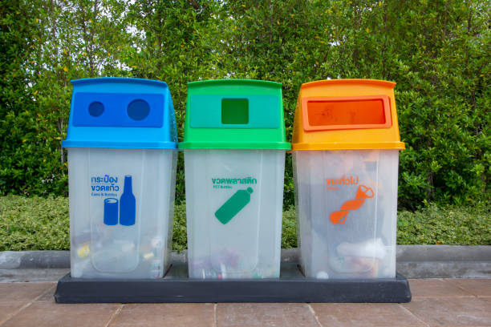
WASTE SEGREGATION
Segregation of our waste is essential as the amount of waste being generated today caused immense problem. There are certain items are not Bio Degradable but can be reused or recycled in fact it is believed that a larger portion of the waste can be recycled, a part of can be converted to compost, and only a smaller portion of it is real waste that has no use and has to be discarded.

Slide 4

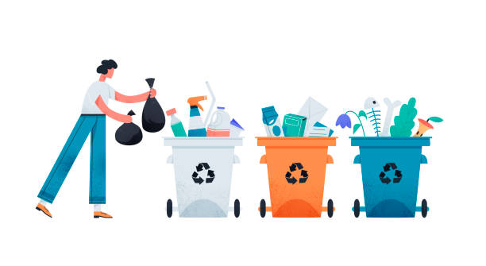
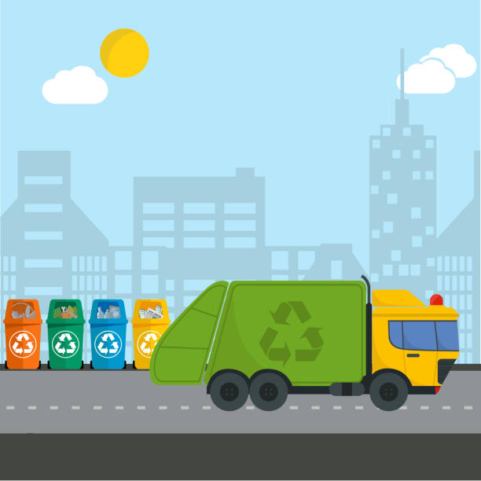
Waste segregation is an essential step to boost the process of recycling.
The importance of waste segregation is something
The importance of waste segregation is something that we can no longer afford to ignore. The situation is much the same in the UK. In 2018, only 44.1% of municipal waste was successfully recycled. Admittedly, this was an increase from the rate of 43.8% in the previous year.

Slide 5

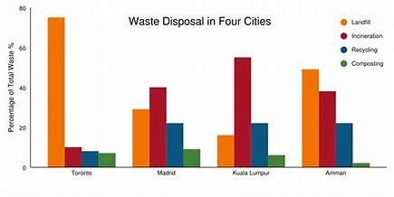
Essential Method of Segregation of Solid Waste!
Manual sorting operation:
Manual sorting operation comprises of,
1. Unloading the waste
2. Manually (with protective measures) spreading the waste

Slide 6
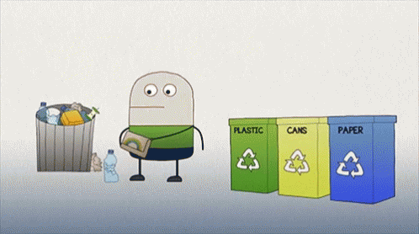
Waste Segregation Meaning
Non-solid
This type of waste will be put in the blue box
NO
Waste
Solid waste or not
YES
Solid waste
This type of waste will be transferred to green box.

Slide 7
Solid Waste Segregation
Solid waste
Paper waste
Glass waste
Metal waste
Plastic waste
YES
YES
YES
YES
Segregates to the green box
Segregates to the green box
Smart municipal authority.(call automatically when filled)

Slide 8
Smart Dustbin
Call to the authority
END
YES
START
Waste Input
Filled or not
NO
Not filled

Slide 9
Our Solution
Working Concept
It is important to dispose of the trash properly. It is a responsibility with which everyone should comply. In the era of Covid-19, people are trying to innovate everyday life things and make things as contactless as possible. Smart dustbin is one of those innovative ideas.
The smart dustbin uses an Ultrasonic sensor HC-SR04 to detect objects in front.
It then sends the signals to Arduino Uno. The Arduino understands the signal and sends a signal to the Servomotor which opens the flap on top of the dustbin.
Smart dustbin
The smart dustbin uses an Ultrasonic sensor HC-SR04 to detect objects in front. It then sends the signals to Arduino Uno. The Arduino understands the signal and sends a signal to the Servomotor which opens the flap on top of the dustbin.

Slide 10
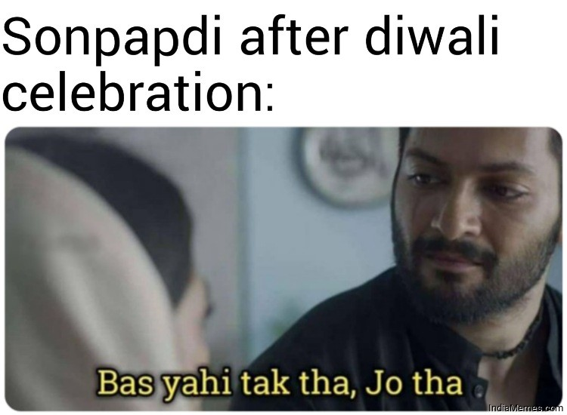

Thank you

